Slide 1


Final Year Project
Computer On Wheels
Supervised By: Dr. Naveed Ikram(Professor/Associate Dean)

Slide 2
Project Team
Bilal Rafiq (27661)
Hamza Azhar(28595)
Sardar Mohsin (28016)
M. Usama Nazir (30445)

Slide 3
Table of Content
Opportunity & Stakeholders
Existing Systems
Problem Statement
Endeavour (Team + Work + Way of Working)
System
Requirements Summary
Design Summary
Implementation Summary
Testing & Evaluation Summary
Conclusion and Outlook

Slide 4
Opportunity & Stakeholders

Slide 5
Opportunity(1/3)
According to a National Highway Traffic Safety Administration (NHTSA) study, driver error led to 94% of the crashes examined.
According to the U.S. General Services Administration (GSA), human error causes 98% of crashes.

Slide 6
Opportunity (2/3)
A 2017 study by RAND Corporation found that self-driving cars could reduce traffic fatalities by up to 25% by 2040.
A 2019 study by the National Highway Traffic Safety Administration (NHTSA) found that self-driving cars were involved in fewer crashes than human-driven cars per mile driven.
A 2020 study by the Massachusetts Institute of Technology (MIT) found that self-driving cars could prevent up to 90% of crashes caused by human error.

Slide 7
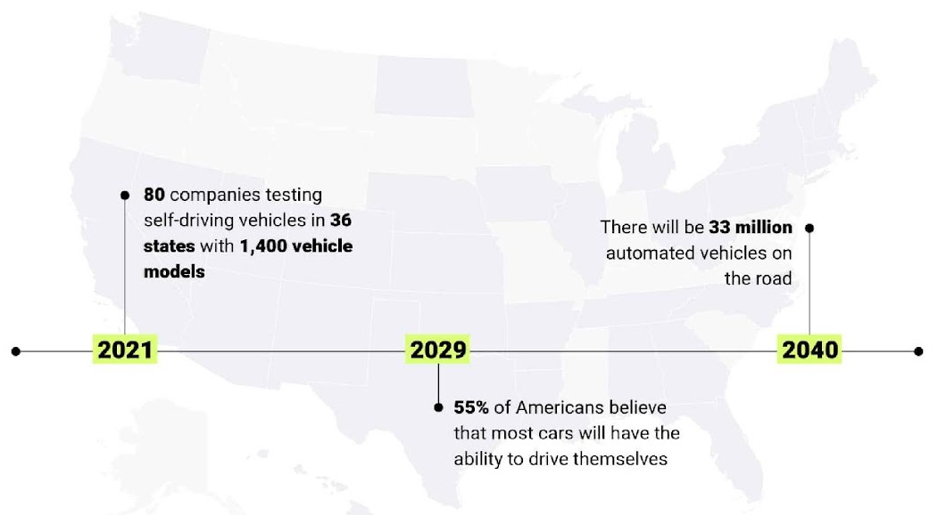
Opportunity (3/3)

Slide 8
Stakeholders
Driver
Passengers
Vehicle Owner

Slide 9
Existing systems

Slide 10
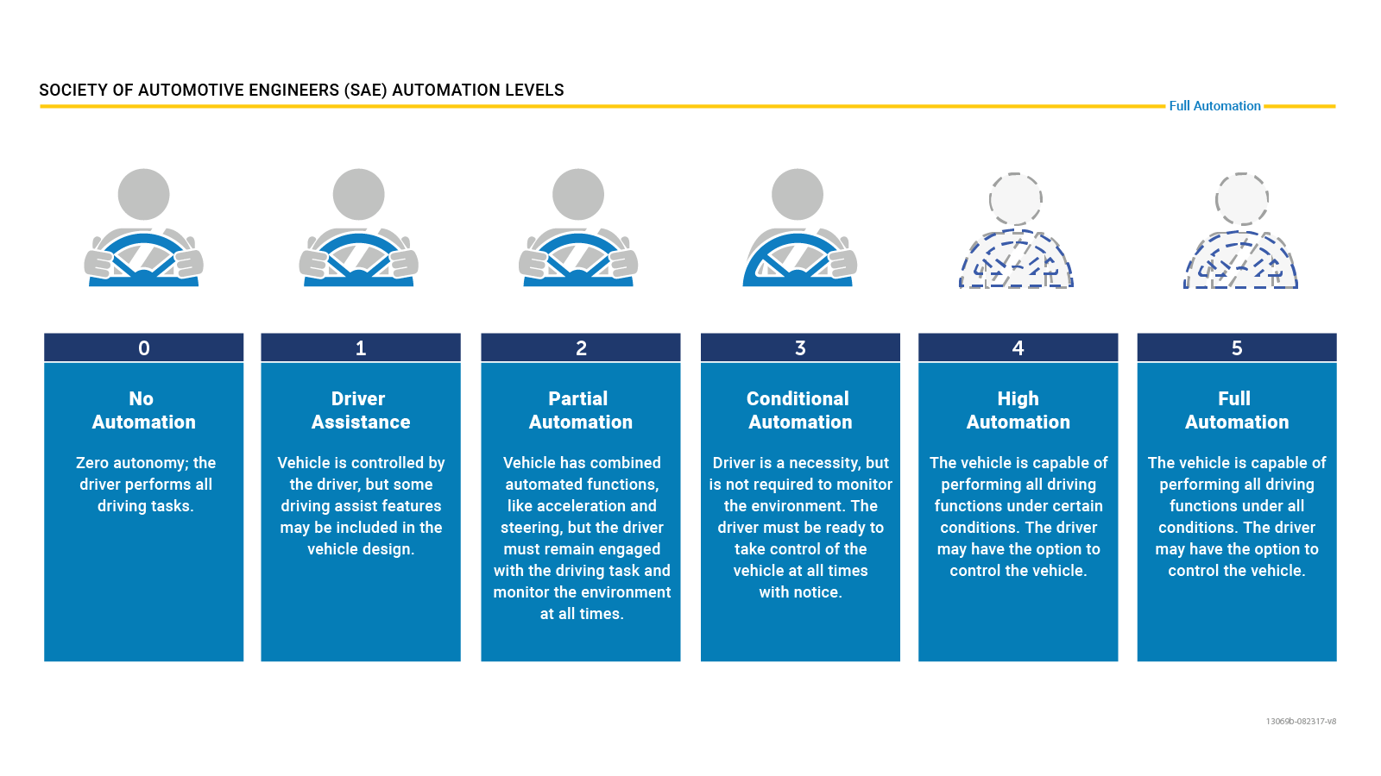
Levels of Autonomous Vehicle
Notes:
The Society of Automotive Engineers (SAE) International has defined six levels of driving automation, ranging from Level 0 (no automation) to Level 5 (full automation). As of today, only Levels 0, 1, and 2 are commercially available in production vehicles.

Slide 11
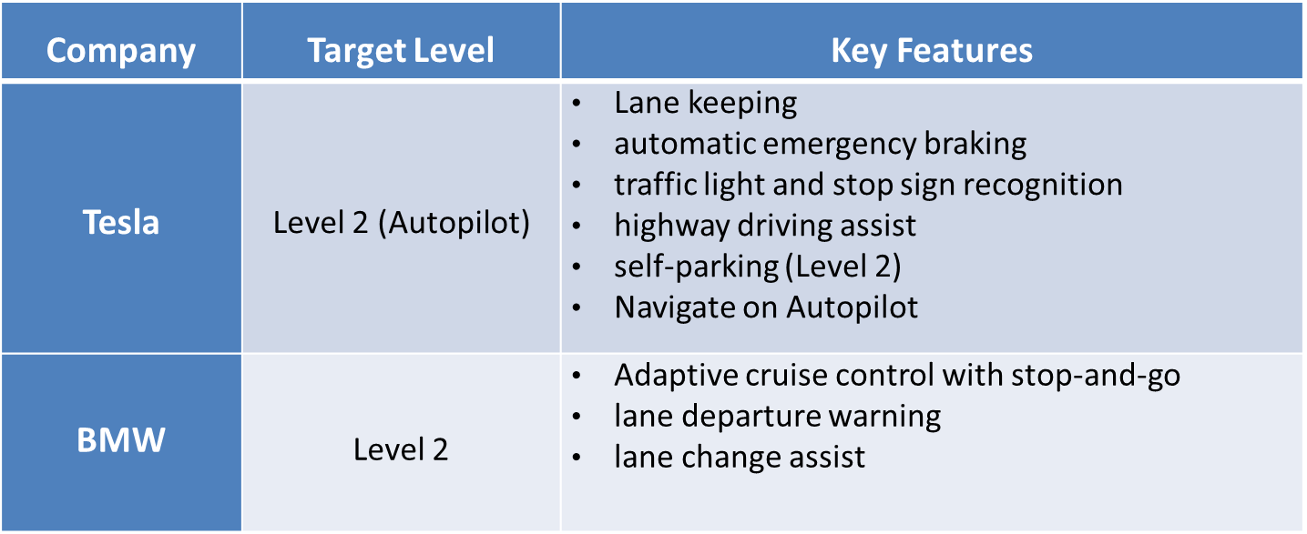
Existing Systems (1/2)
Notes:
As of early 2024, no commercially available vehicles are fully autonomous, but many automakers are developing Level 4 and Level 5 vehicles.
As of March 5, 2024, commercially available vehicles primarily fall under Level 2 on the SAE International's J3016 classification system for automated driving. This signifies that they offer advanced driver assistance systems (ADAS), but not full autonomy.
While some companies, like Honda, Mercedes-Benz, BMW Group, and Kia, have received approvals for Level 3 vehicles in specific regions, these are still in limited deployment and not widely available to the public. Level 3 allows for conditional automation under certain conditions, where the driver can take their eyes off the road for brief periods.

Slide 12
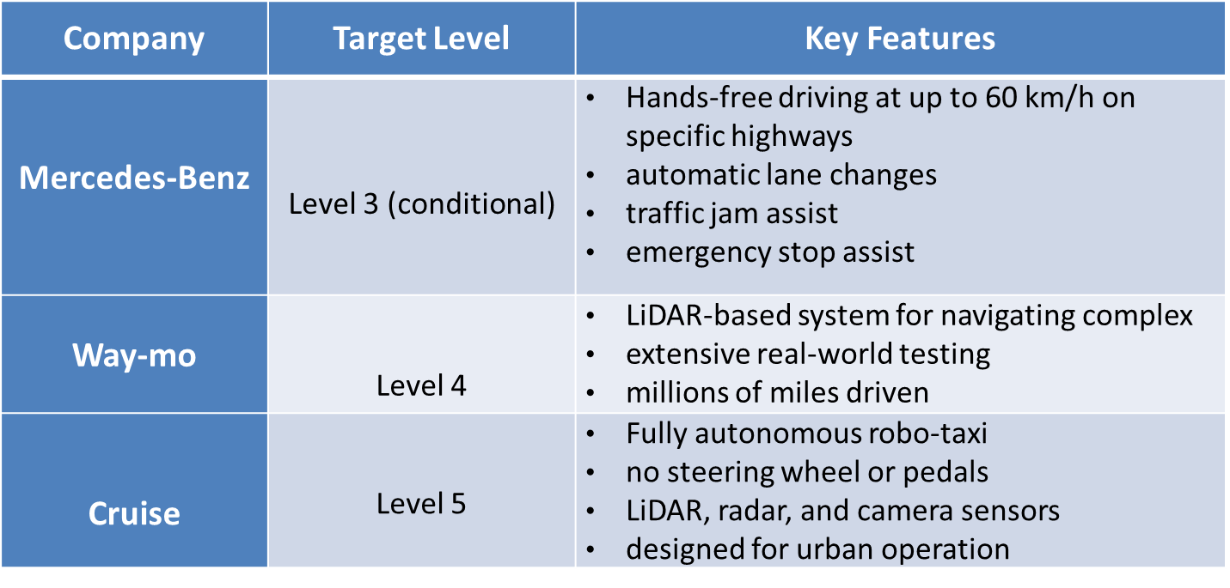
Existing Systems (2/2)
Notes:
Tesla, BMW: Path Planning and following:
employ a variety of path planning algorithms, including:
Graph search:
Probabilistic roadmaps (PRMs)
Learning-based methods
Model predictive control
Obstacle Detection and Avoidance:
not publicly known (DEEP MACHINE LEARNING)
Mercedes (no disclosed)
Waymo and cruise doesn't disclose the specific algorithms they use but use High-definition (HD) maps: These detailed maps provide information about the environment, including lane markings, traffic signals, and points of interest. The system can leverage these maps for path planning within the designated areas.

Slide 13
Problem Statement

Slide 14
Problem Statement(1/3)
Problem Statement # 1: Safety Challenges
The problem of | Inadequate safety measures for autonomous navigation in adverse weather conditions.
Affects | Passengers, pedestrians and other road users.
The result of which | Increased risk of accidents due to reduced visibility, leading to injuries or fatalities.
Benefits of | Improved safety protocols to ensure reliable operation of autonomous vehicles in varying environmental conditions.

Slide 15
Problem Statement(2/3)
Problem Statement # 2: Challenges in Simulation for AV Software Development
The problem of | Inadequate utilization of simulation environments (CARLA) for developing and validating ROS-based autonomous vehicle software.
Affects | Developers and researchers in autonomous vehicle systems.
The result of which | Slower development cycles, higher costs of physical testing, and potential safety risks due to insufficient validation.
Benefits of | Enhanced efficiency and safety through thorough evaluation of autonomous algorithms under varied conditions before deployment.

Slide 16
Problem Statement(3/3)
Problem Statement # 3: User Acceptance Challenges for Autonomous Vehicles.
The problem of | Limited user acceptance of autonomous vehicle technology due to perceived safety and reliability concerns.
Affects | Potential users, stakeholders, and the overall adoption of autonomous vehicles.
The result of which | Resistance to adopting autonomous vehicles, leading to slower market penetration and reduced investment in further development and innovation.
Benefits of | Building user confidence through improved transparency, education, and demonstrations of safety features in various conditions, which can enhance the acceptance and integration of autonomous vehicles in everyday life.

Slide 17
Endeavour

Slide 18
Endeavour
Describe roles of your team members
Describe your software development process
Describe your way of working as a team

Slide 19
Software Development Process (1/7)
Adopted the Waterfall model for a structured and disciplined approach.
Suitable for embedded software development in autonomous vehicles.
Ensured clear requirements, detailed design, rigorous testing, and documentation.

Slide 20
Software Development Process (2/7)
Requirements Gathering and Analysis
Comprehensive Analysis: Defined functional and non-functional requirements.
Consultation with Domain Experts: Ensured expert input and thorough documentation review.
Clear Objectives: Established project objectives from the beginning.
Artifact:
Appendix-A: Software Requirements Specifications (SRS)7.0
Appendix-D1: Requirement Inspection.

Slide 21
Software Development Process (3/7)
System Design
Architecture: Translated requirements into a detailed system architecture.
Use Case Documentation: Defined key use cases for the system.
State Chart Approach: Developed state charts at both the abstract system level and the module-specific level, instead of traditional activity diagrams.
Rationale: Best suited for embedded systems, providing clarity on system states and transitions.
Artifacts in System Design:
Appendix-B: Design Document

Slide 22
Software Development Process (4/7)
Implementation
Code Development: Followed Waterfall model guidelines for systematic development.
Module Development: Focused on key modules like path planning, obstacle detection, and control.
Code Quality: Emphasis on clean, well-documented code aligned with project specifications.
Artifacts in Implementation:
Appendix-C: Coding Standards

Slide 23
Software Development Process (5/7)
Integration and Testing
Rigorous Testing: Validated functionality and ensured smooth integration.
Testing Types: Conducted unit testing, integration testing, and system testing.
Real-World Scenarios: Focused on testing in conditions like adverse weather, obstacle detection, and traffic light recognition.
Artifacts in Testing:
Appendix-D2: Design (Scenario-Based) Testing
Appendix-D3: White Box Testing
Appendix-D4: Black Box (System) Testing

Slide 24
Software Development Process (6/7)
Project Management & Documentation
Work Breakdown Structure: Defined task distribution and milestones.
Artifact: Appendix-E: Work Breakdown Structure
Roles & Responsibilities: Clearly outlined team roles and responsibilities.
Artifact: Appendix-F: Roles & Responsibility Matrix

Slide 25
Software Development Process (7/7)
Phase Sign-Offs
Formal sign-offs from the project supervisor(s) at each phase.
Ensured all objectives were met before progressing to the next phase.
Detailed Documentation
Meticulous documentation of requirements, design decisions, and test cases.
Provided clear reference for future maintenance and updates.

Slide 26
Way of working as a team (1/3)
Ad-hoc meetings
Version Control: Git and GitHub
Project Management: Jira Issue Tickets
File Sharing: Google Drive/WhatsApp
Online Meetings: Google Meet
Notes:
Ad-hoc: Ideal for addressing unexpected issues or clarifying doubts that arise during feature development or code reviews.

Slide 27
Way of working as a team (2/3)
Industry Workspace Collaboration
Feedback from Industry Employees
Interaction with Domain Experts
Knowledge Sharing Sessions
Code Reviews

Slide 28
Way of working as a team (3/3)
Retrospectives Meetings
Continuous Learning and Development Sessions
Milestone Reviews
Emails
Feedback Loop: Regular Performance Reviews
Notes:
Conduct retrospective meetings at the end of each sprint to reflect on what went well, what didn’t, and how processes can be improved.

Slide 29
System
Overview of the Embedded System
Designed for personal autonomous vehicle use
Allows navigation to predefined destinations safely and independently
Operates in a controlled environment with real-world scenario adaptation (e.g., obstacle detection, traffic light recognition)
Minimizes human intervention

Slide 30
Requirements Summary (1/2)
Requirements Gathering Techniques
Interview with Domain Experts:
Developed a structured questionnaire to gather insights from domain experts
Ensured alignment with industry standards
Document Analysis:
Refined requirements by reviewing research articles and industry documentation

Slide 31
Requirements Summary (2/2)
Software Requirements Specification (SRS):
The SRS Document (detailed in Appendix-A SRS) serves as a central reference for all functional and non-functional requirements. It defines 44 functional requirements and 4 non-functional requirements for an embedded software system for personal use.
Testing of Requirements
Inspection Testing:
Conducted during the requirements phase to verify clarity, feasibility, and completeness
Documented in Appendix-D1: Inspection
Ensured requirements were precise and actionable

Slide 32
Design Summary
System Architecture (Layered)
Use case diagram
State Chart-Based Design
State Charts over Activity Diagrams: Created for system and module levels
Scenario-Based Testing: Documented in Appendix-B: Design Document
Notes:
All based on implemented requirements of part 1 (From architecture to sequence)

Slide 33
Implementation Summary (1/3)
The software was developed in Python using a range of specialized libraries and modules suited to embedded autonomous systems.
Key libraries included rospy for ROS integration, numpy for numerical computations, OpenCV for image processing, and TensorFlow for potential learning-based applications.
This structure allowed us to meet each of the 44 functional requirements while ensuring efficiency, modularity, and maintainability.
Adherence to Python Coding Standards
Notes:
All based on implemented requirements of part 1 (From architecture to sequence)

Slide 34
Implementation Summary (2/3)
IDEs
PyCharm
Visual Studio Code
Development Platform
Ubuntu
ROS (Robot Operating System)
Notes:
All based on implemented requirements of part 1 (From architecture to sequence)

Slide 35
Implementation Summary (3/3)
White-Box Testing
Validated internal logic of each module to ensure functional specifications were met, focusing on code structure and logical flow.
Artifact: Appendix-D3: White Box Testing
Appendix-C: Coding Standards – Contains the coding standards followed for consistency, readability, and maintainability.
Notes:
All based on implemented requirements of part 1 (From architecture to sequence)

Slide 36
Testing & Evaluation Summary
Requirements Phase: Inspection testing to verify clarity and feasibility of requirements.
Design Phase: Scenario-based testing to validate module functionality in real-world scenarios.
Implementation Phase: White-box testing to verify internal logic of each module.
System Phase: Black-box testing to evaluate overall system functionality in real-time scenarios.
Artifacts
Appendix-D2: System Design Testing
Appendix-D3: White Box Testing
Appendix-D4: Black Box Testing

Slide 37
Conclusion and Outlook

Slide 38
Conclusion
Successfully demonstrated an embedded autonomous driving software system for personal use.
Implemented key functionalities: path planning, path following, obstacle detection and avoidance, and traffic light recognition.
Integrated ROS and CARLA for real-time testing, validation, and performance evaluation.
Adhered to rigorous software development standards, enhancing road safety by reducing human error.
Provided a robust foundation for future personal autonomous vehicle applications.

Slide 39
Outlook
Future Developments
Integrate advanced sensor fusion techniques for improved obstacle detection.
Enhance path-following capabilities for more accurate navigation.
Use ML/Ai for Traffic light as well
Key Focus Areas
Adapt system to various environmental conditions for real-world deployment.
Increase autonomy and optimize computational efficiency.
Expand system flexibility for broader applications in diverse geographic and operational environments.

